Slide 1
σ
E
F
B
C’
A
C
D
ε

Slide 2
σ
ε
Linear Elastic

Slide 3
σ
ε
NonLinear Elastic

Slide 4
σ
ε
Elastoplastic or Viscoplastic

Slide 5
σ
ε
Perfectly Plastic

Slide 6
σ
ε
Elastoplastic with strain hardening

Slide 7
σ
ε
Ideal Rigid

Slide 8
σ
ε
Ideal fluid

Slide 9
Δ
h
φ

Slide 10
50KN
15KN
10KN
45KN
A
0.6m
B
1m
C
1.25m
D
15KN
35KN
35KN
50KN
35KN
50KN
50KN
45KN
10KN

Slide 11
A1 E1
P
P
A2 E2

Slide 12




y
II
x
I
SF/BM = y(x)
IV
III
x
y

Slide 13
P
a
=
a
P
2Pa
P
a
=
P
Pa
P
P
a
=
a
Pa

Slide 14
1
5cm
8cm
1
2
4cm
=
2
2cm
3
3
4
4cm
4
Centroid = 1 + 2 + 4 -3

Slide 15
y
t
dx
H
x
L
u
X

Slide 16
A
y
b
y
5cm
D
F
E
b
y
y
G
B
8cm
C
dy
10cm
Element
X

Slide 17
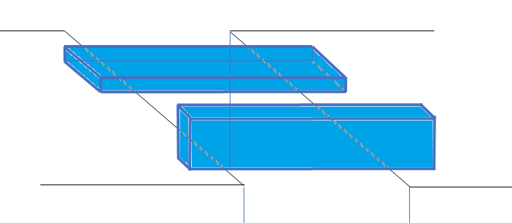
Bending Axis

Slide 18
y
y
dx
dy
d/2
d/2
x
y
x
x
c
c
d/2
d/2
b/2
b/2
b/2
b/2

Slide 19
y
y
y
y
c
c
dx
x
dy
d
x
d
x
c
c
c
c
y
D1 = d/2
D2 = b/2
x
x
0
0
b
b

Slide 20
y
x
ρ
y
x

Slide 21
y
ρ+dρ
ρ
x
R

Slide 22
y
y
k
x
x

Slide 23
Before Bending
After Bending
Compression side – Top fibres are compressed
Neutral Axis
Tension side – Bottom fibres are stretched
Cross section before bending
Cross section after bending

Slide 24
Cross Section
Compression
-
Neutral Axis
+
Simply supported
Tension
Bending Stress
Cross Section
Tension
+
Neutral Axis
-
Cantilever
Compression
Bending Stress

Slide 25
σmax
dA
Ymax
σ
Ymax
y
y
Neutral Axis

Slide 26
b
mb
1
2
1
b/m
1
2
2
Composite
Equivalent section made of Material 2
Equivalent section made of Material 1

Slide 27
t
σw
steel
σs
d/2
Wood
Neutral Axis
d/2
t
steel
Bending Strain
Bending Stress

Slide 28
b
mb
b
Steel
Wood
Steel
b/m
Wood
Wood
Steel
b
Steel
Wood
Steel

Slide 29
t
b
t
σw
σs = mσw
d
Steel
Wood
Steel
Bending Strain
Bending Stress in Wood
Bending Stress in Steel

Slide 30






b
$$τ$$
B
avg
A
G
$$\frac{d}{2}$$
E
F
b
ӯ
$$\frac{d}{2\sqrt{3}}$$
$$τ$$
y
max
A
B
NA
$$\frac{d}{2}−y$$
d
$$\frac{d}{2\sqrt{3}}$$
E
F
D
C

Slide 31


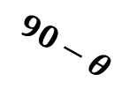

g
f
x
w
A
A
d
c
g
d
g
$$θ$$
e
P
x
n
h
Px
$$θ$$
Px
Px
a
b
$$90−θ$$
$$θ$$
h
a
h
a
A
P
t

Slide 32


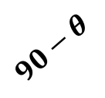

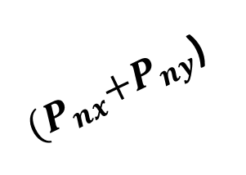
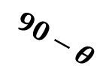


P
ty
Py
g
f
A
Py
x
w
g
d
g
$$θ$$
${(P}_{nx}+P_{ny}$)
x
$$90−θ$$
d
c
Px
$$θ$$
Px
$$θ$$
Px
e
h
$$90−θ$$
1
$$θ$$
3
5
h
a
h
a
a
b
A
Py
x
w
P
tx
c
d
$$θ$$
2
4
a
b

Slide 33




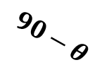











A
$$S1Cosθ$$
$$τ_{xy}$$
${S1= τ}_{yx}$A(abcd)
g
d
x
w
g
$$θ$$
x
$$τ_{xy}$$
x
$$90−θ$$
$$S1Sinθ+S2Sin(90−θ)$$
c
d
$$θ$$
$$τ_{yx}$$
$$θ$$
$$τ_{yx}$$
S2 = $τ_{xγ}$A(dcwx)
$$τ_{yx}$$
$$90−θ$$
a
$$θ$$
h
a
b
h
a
$$τ_{xy}$$
A
$$S2Cos(90−θ)$$

Slide 34






A
$$ε_{y}$$
$$ε_{y′}$$
$$ε_{x^{′}}$$
$$θ$$
$$ε_{x}$$
$$θ$$
A

